Slide 1
BA Assignment4
16102284 Lee SungHo

Slide 2
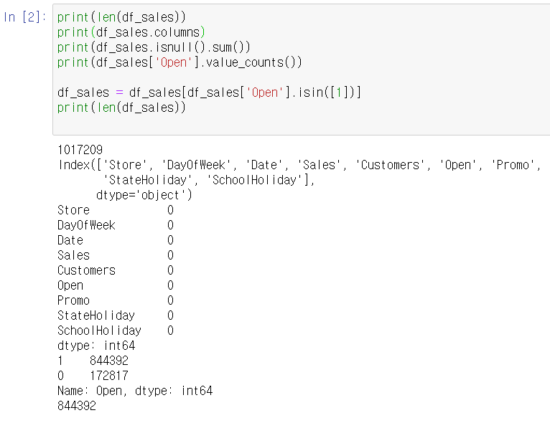
EDA
First, I check descriptive statistics at ‘sales.csv’.
As a result the number of row is 1017209. And column is 'Store', 'DayOfWeek', 'Date', 'Sales', 'Customers', 'Open', 'Promo’, 'StateHoliday', 'SchoolHoliday’. And there is no null variable at this dataframe. Final goal is to predict one week after sales, so I remove non open store data

Slide 3
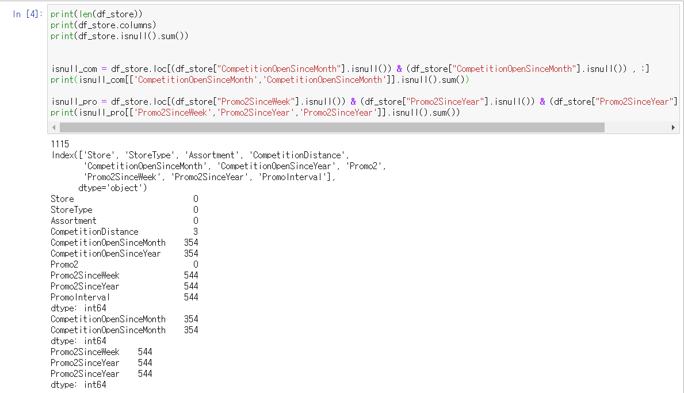
EDA
Second, I check descriptive statistics at ‘store.csv’.
As a result the number of row is 1115. And column is 'Store', 'StoreType', 'Assortment’, 'CompetitionDistance’, 'CompetitionOpenSinceMonth’, 'CompetitionOpenSinceYear', 'Promo2’, 'Promo2SinceWeek', 'Promo2SinceYear', 'PromoInterval'. And there are null variable at this dataframe.
An object with only one null value was used to verify that it was present. As a result, if a null value occurs in similar columns, you can see that other columns also have a null value.

Slide 4
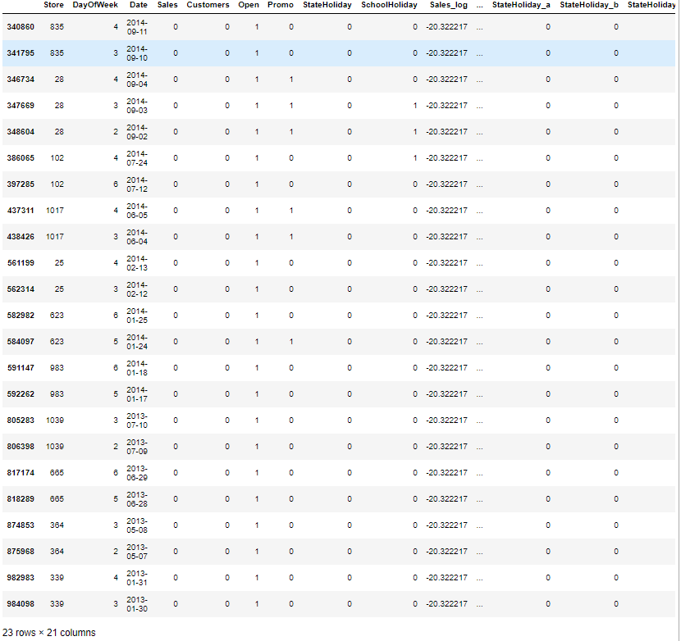
EDA – Open
And I filter data that store is open and sale in 0 and it appears more than one day. Interest thing is, there is occurred on consecutive dates except store 102.

Slide 5
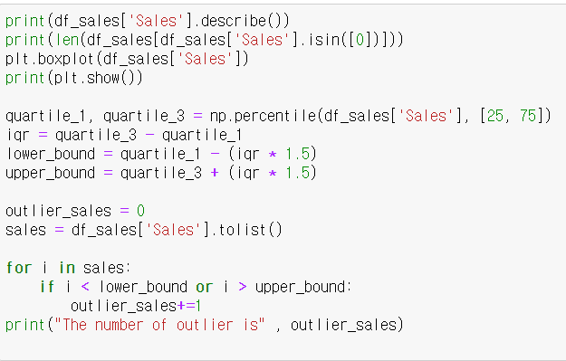
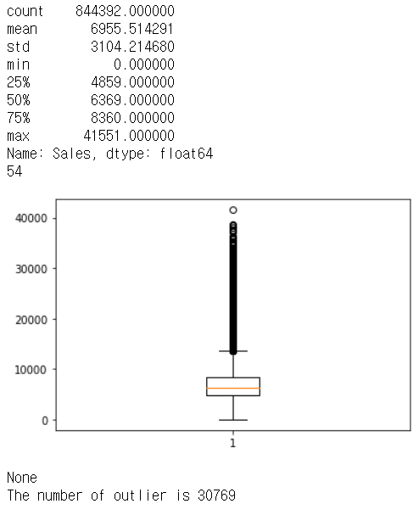
EDA - Sales
And I check target data ‘Sales’. The interesting thing is, there are 54 stores that have opened but have zero profits. And through boxplot graph and sales’s describe, the graph is right crewed graph and there are 30,769 outlier data using Tukey/Carling function.

Slide 6
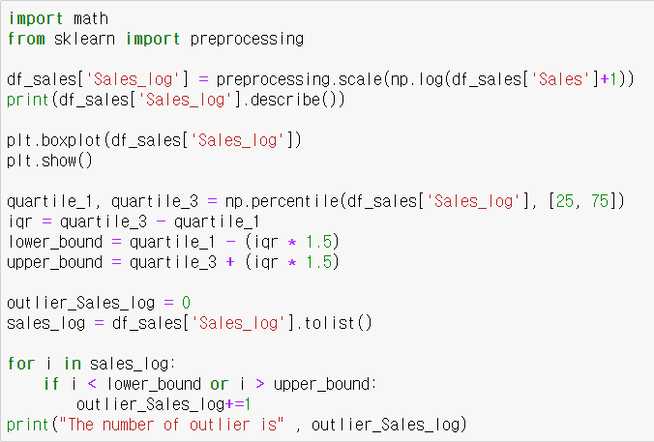
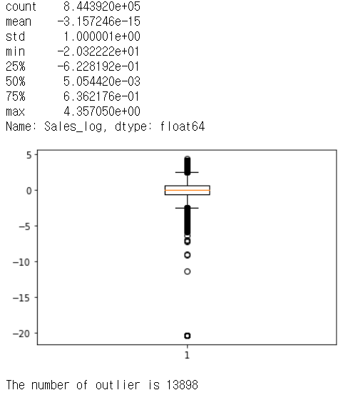
EDA - Sales
And I scale target data for multiply log. As a result, there are 13,898 outlier which is decrease before

Slide 7
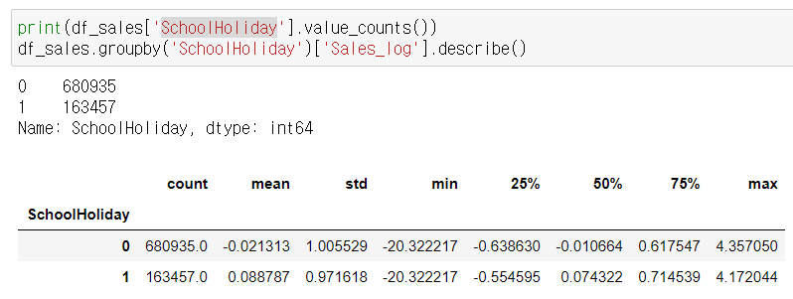
EDA – SchoolHoliday
And I print descriptive statistics group by school holiday. And this is a result. I think both mean and variable is very similar

Slide 8
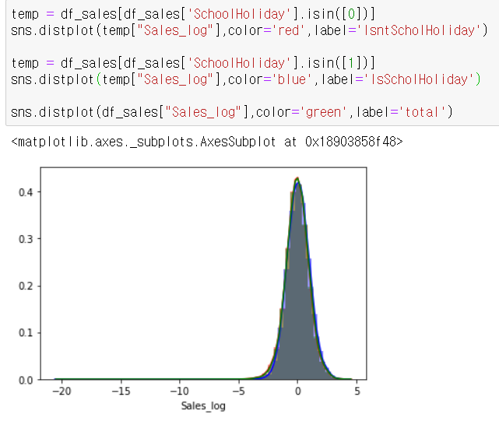
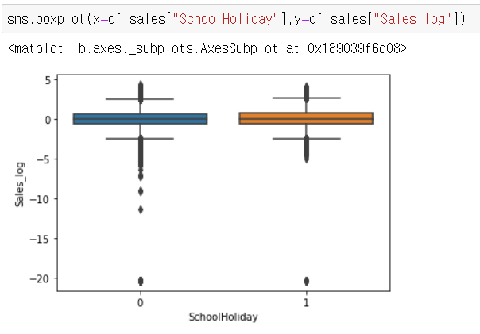
EDA – SchoolHoliday
Moreover, I draw graphs histogram and boxplot. Like these graph, graph show that there is no difference about the target. So I think this variable can’t present target.

Slide 9
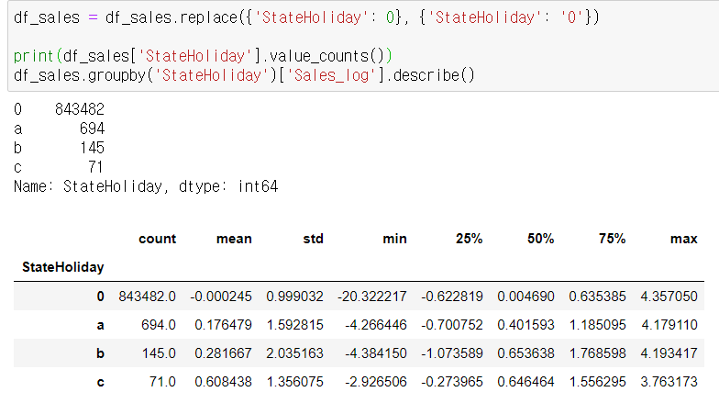
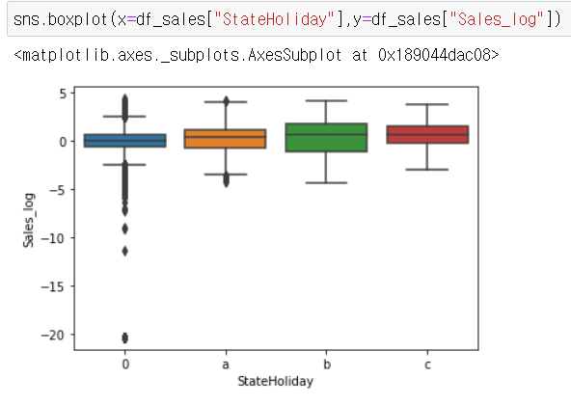
EDA – StateHoliday
Next, I print descriptive statistics group by state holiday and draw boxplot. I think variable ‘c’ data is quite big using central limit theorem, and it is different each variables. So I think this variable can represent target.

Slide 10
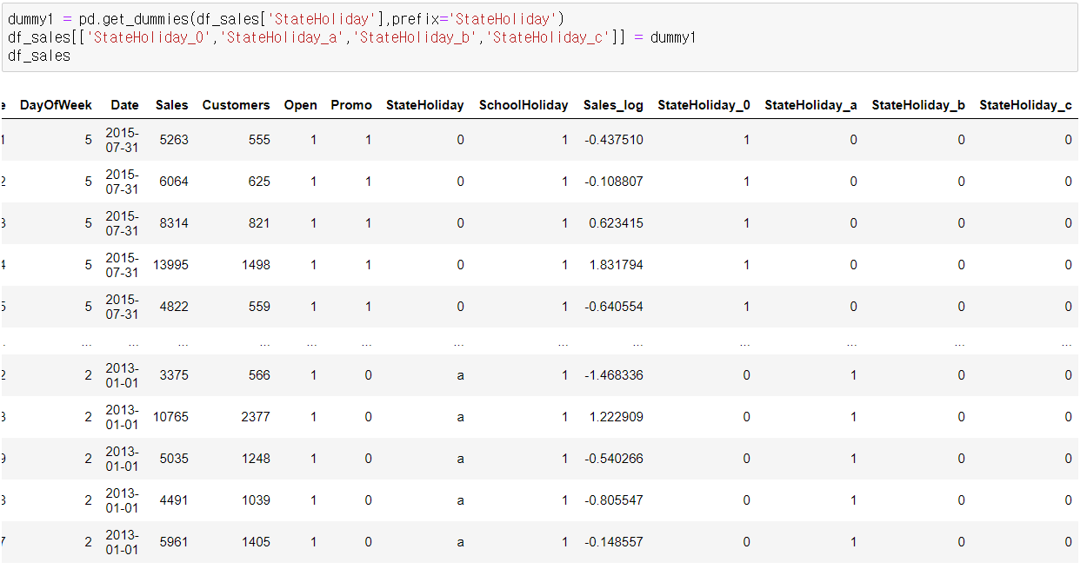
EDA – SchoolHoliday
So I change variable ‘StateHoliday’ to dummy variable, and this is result.

Slide 11
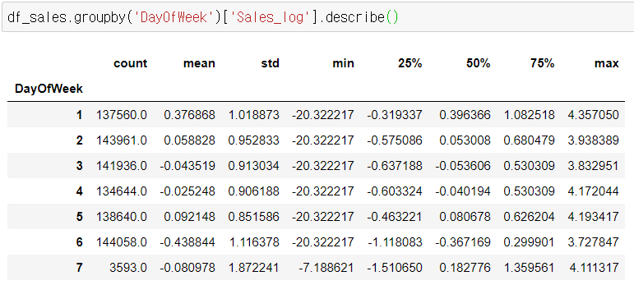
EDA – DayOfWeek
Next, I print descriptive statistics group by Day of Week. There will be differences on each day of the week. And this is a result. I think both mean and variable isn’t very similar.

Slide 12
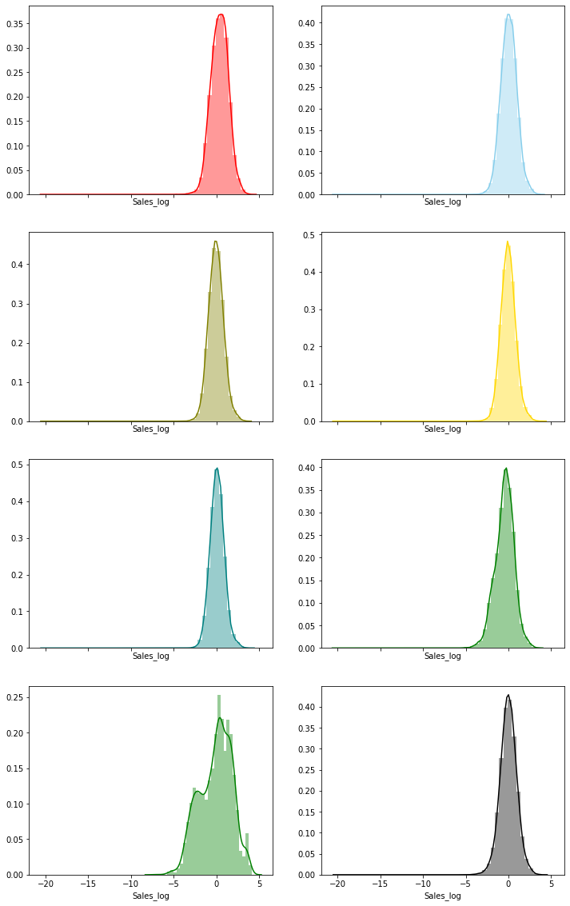
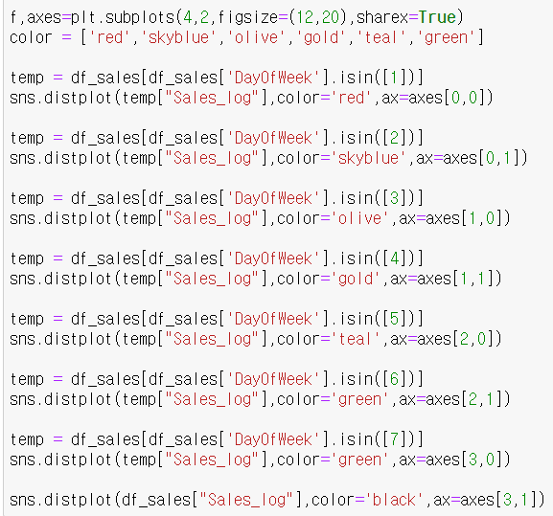
EDA – DayOfWeek
So I draw a histogram of the sales by day. As a result, there is no different except day 7(Sunday).

Slide 13
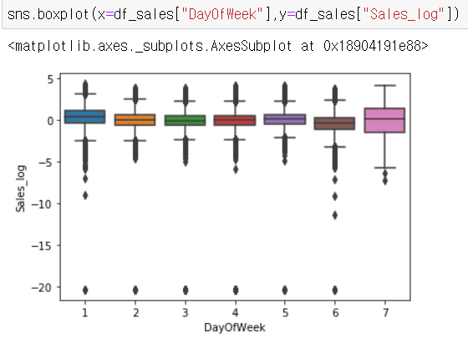
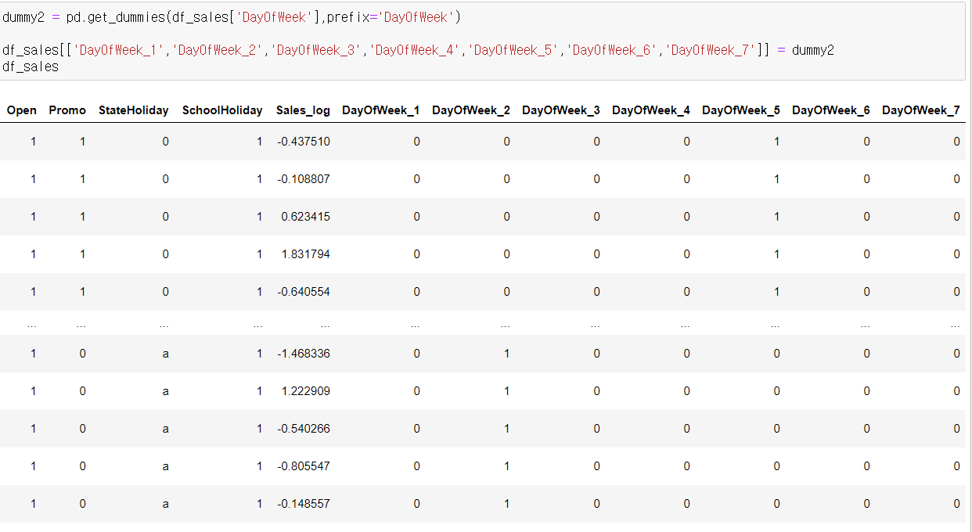
EDA – DayOfWeek
And I draw boxplot. For these results, I think this variable can represent target. So I change DayOfWeek variables to dummy data like second picture.

Slide 14
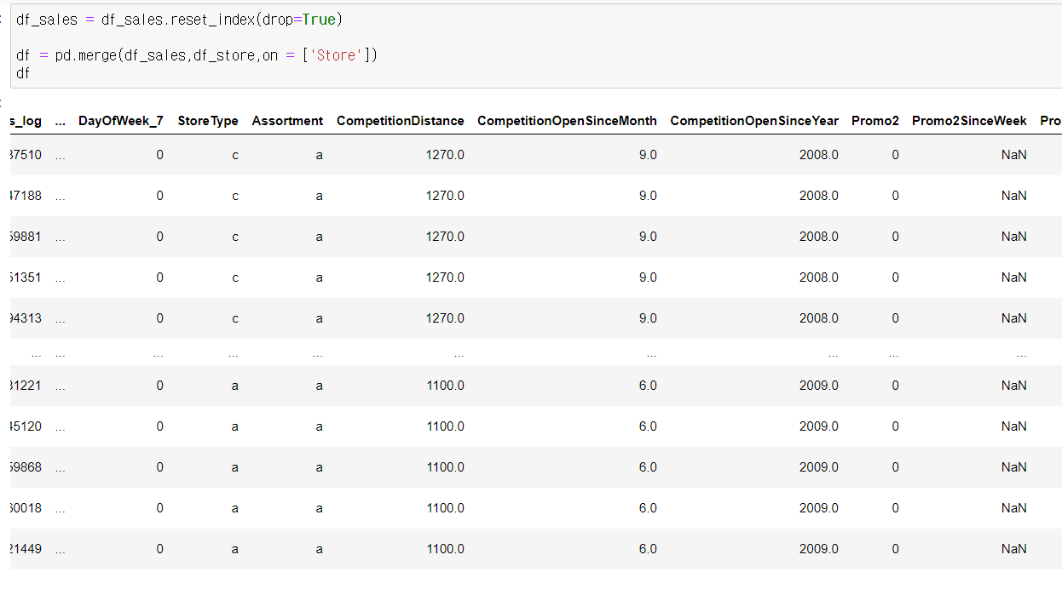
EDA
To analyze store data, the two data frames were combined based on the store column.

Slide 15
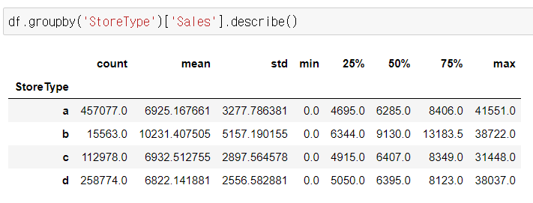
EDA – StoreType
Next, I print descriptive statistics group by Store type. There will be differences on each store type. And this is a result. I think both mean and variable isn’t very similar except b.

Slide 16
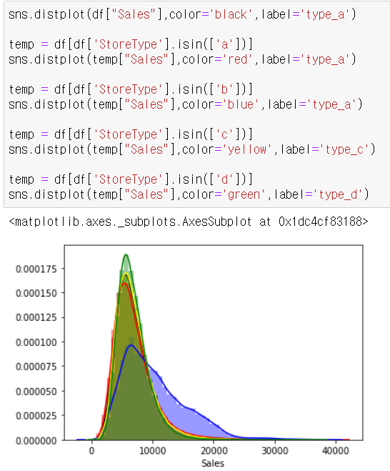
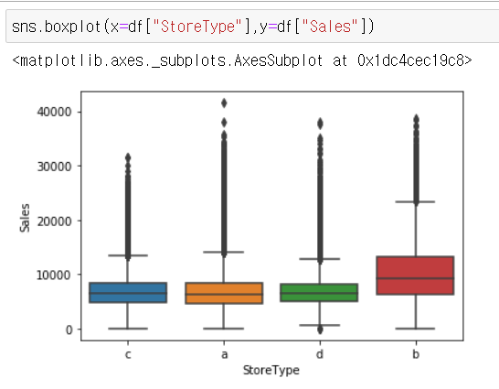
EDA – StoreType
So I make a boxplot and histogram. And I think that the remaining variables are different except for c. So store type variable can represent target data.

Slide 17
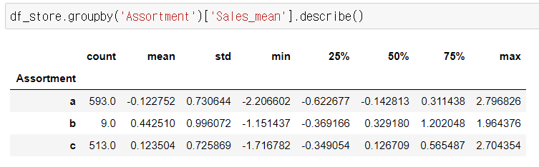
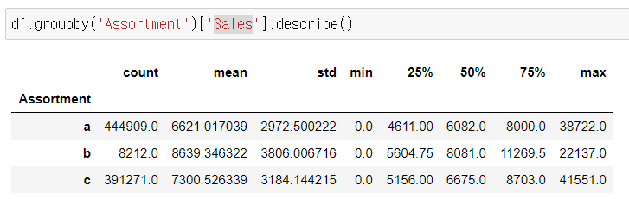
EDA – Assortment
Next, I print descriptive statistics group by assortment. There will be differences on each store type. And this is a result. However b’s count is 9, it is quite small to represent statistical knowledge. This is a reason why I merge. Moreover, I think both mean and variable isn’t very similar except b.

Slide 18
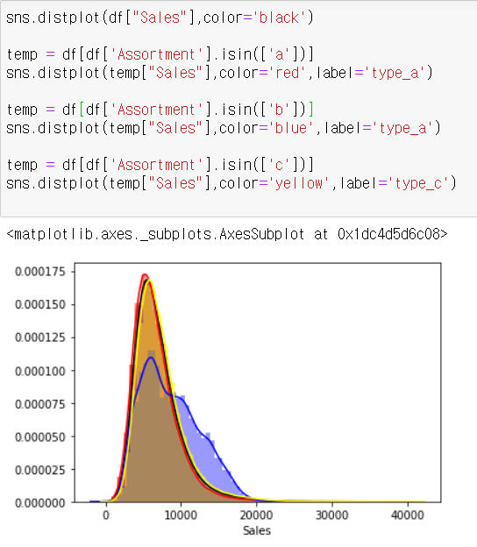
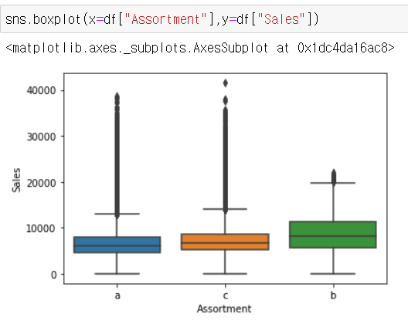
EDA – Assortment
So I make a boxplot and histogram. And I think that the remaining variables are different except for b. So assortment variable can represent target data.

Slide 19

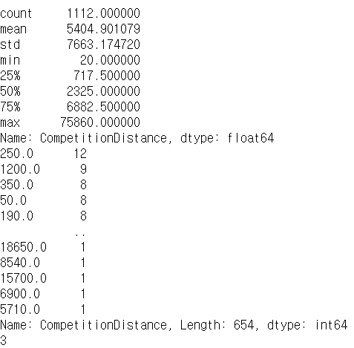
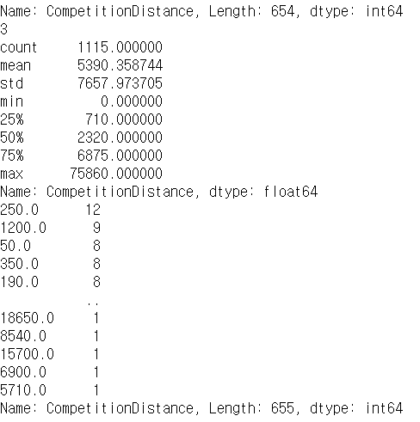
EDA – CompetitionDistance
And there are nulls value at competition distance. So I fill 0 because there is no competition store. And a reason why use df_store column, I think there is no different between showing relation at store data or sales data.

Slide 20
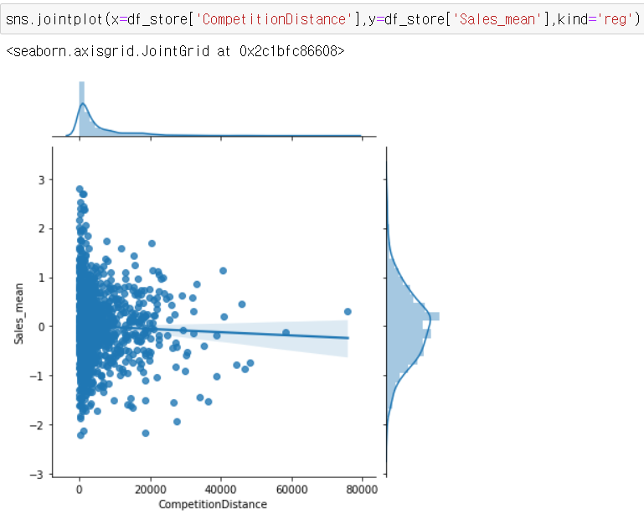
EDA – CompetitionDistance
And I make a graph to show relation between competition distance and sales_mean. But there is no relation I think

Slide 21
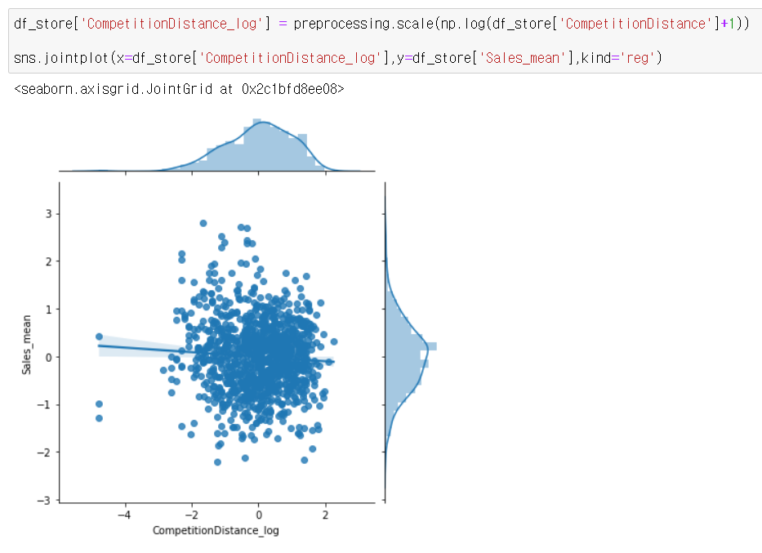
EDA – CompetitionDistance
So I scale data multiply log. But there is no relation still. So I think competition distance can’t represent target data.

Slide 22
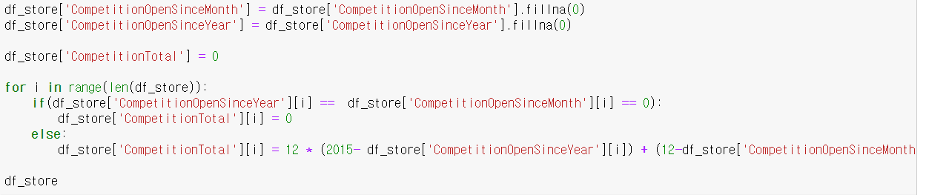
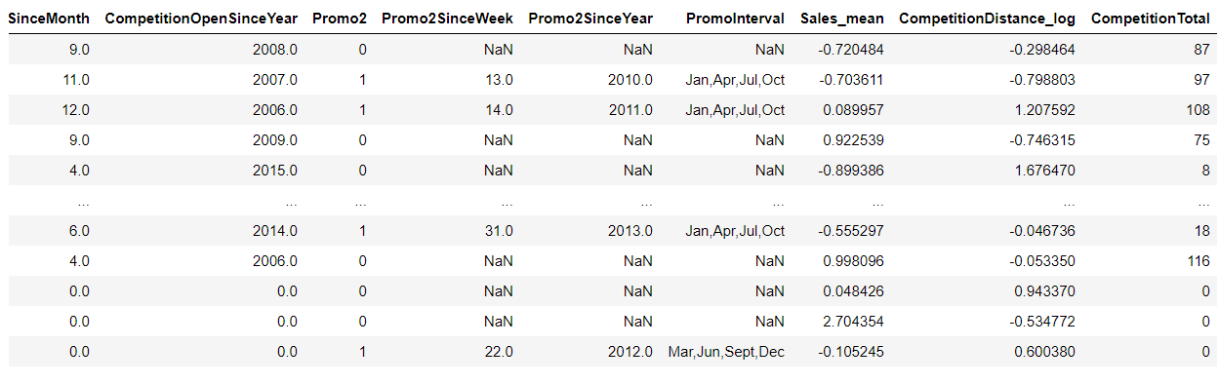
EDA – CompetitionTotal
Then I make a new column ‘CompetitionTotal’ which represent ‘CompetitionOpenSinceYear’ and ‘CompetitionOpenMonth’. So I fill 0 which has no competitor data, and make a fomular. It is 12 * (2015- df_store['CompetitionOpenSinceYear'][i]) + (12 - df_store['CompetitionOpenSinceMonth'][i]). Because last year is 2015.

Slide 23

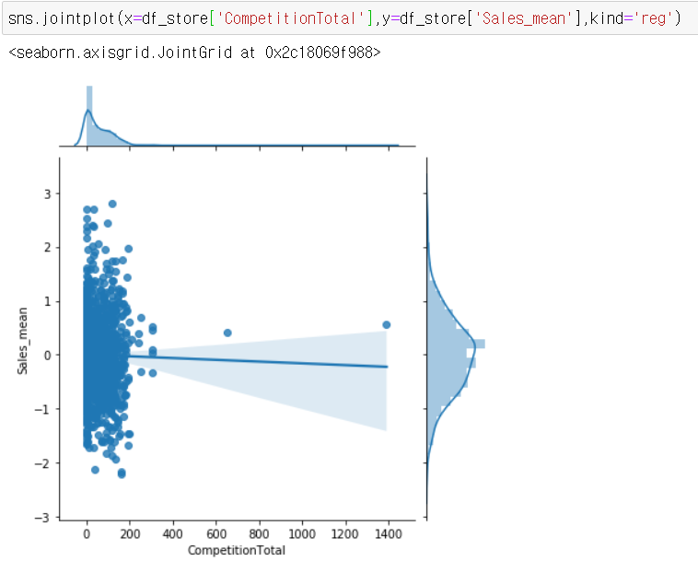
EDA – CompetitionTotal
For input this fomular, I merge sales dataframe and store dataframe. And I draw graph, competitionTotal and sales_mean, to show relation.
As a result, I think it can’t

Slide 24
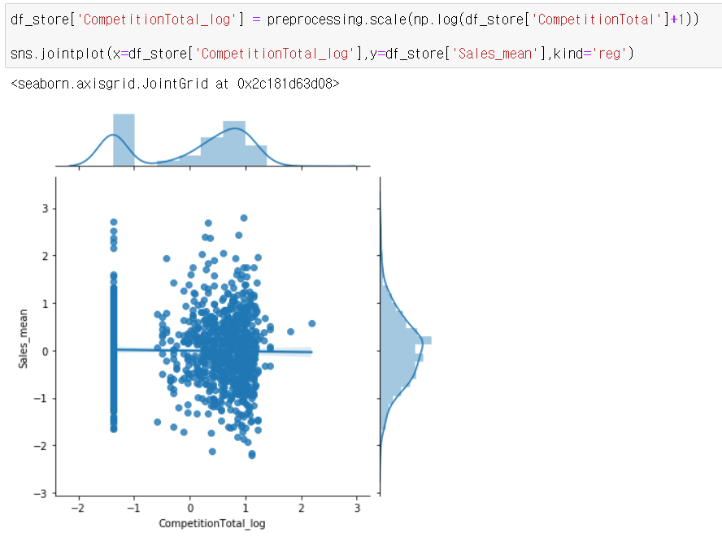
EDA – CompetitionTotal
So I scale data to multiply log data. However there isn’t have relation too. So I thin it can’t represent target value.

Slide 25
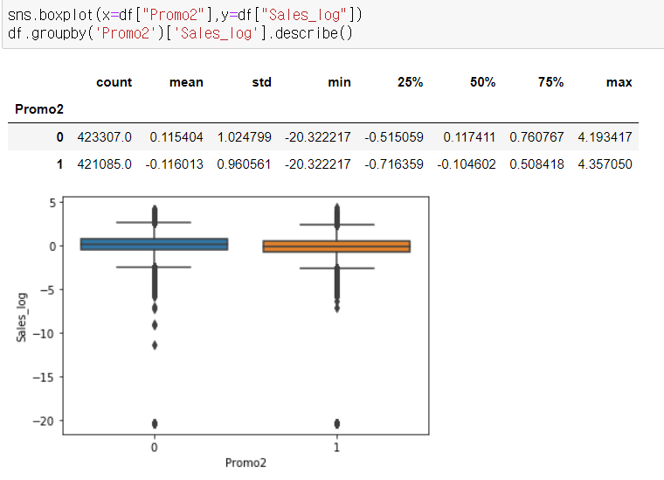
EDA – Pro2
And I draw boxplot and print pro2. As a result, I think there is no different pro2. So I drop this data at predictor variable

Slide 26
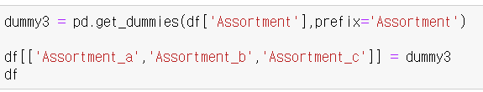
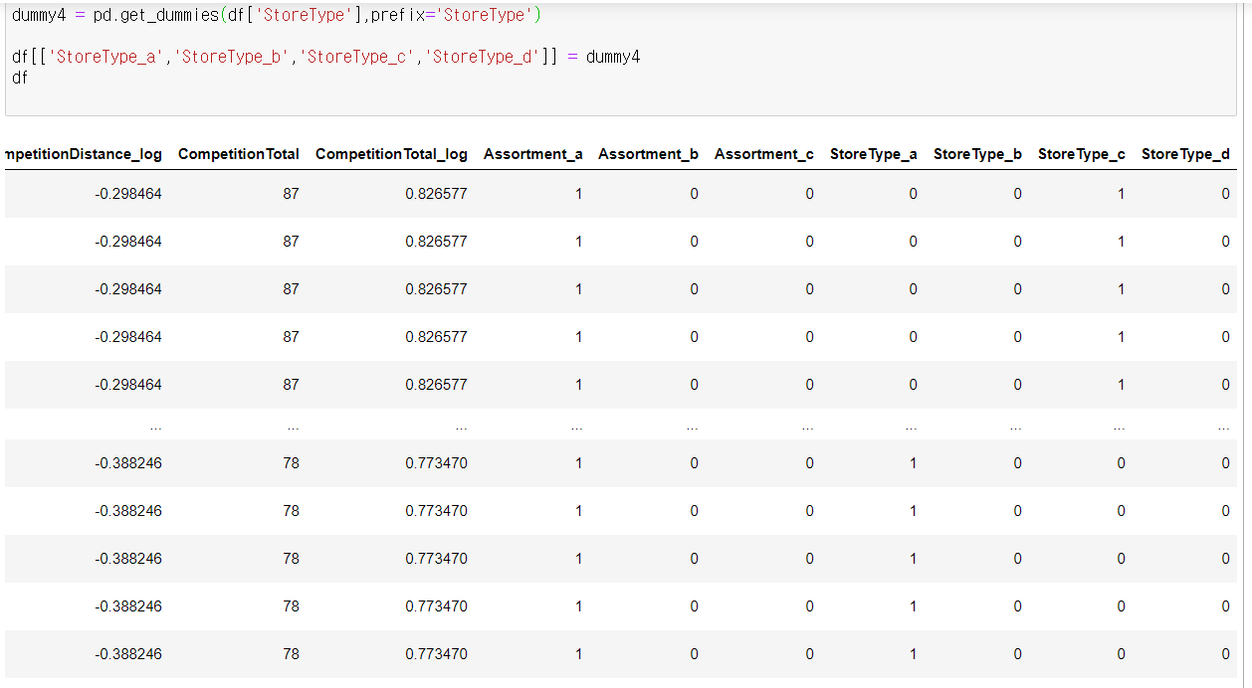
EDA – dump variable
And I change ‘Assortment’ and ‘StoreType’ to dummy variable

Slide 27
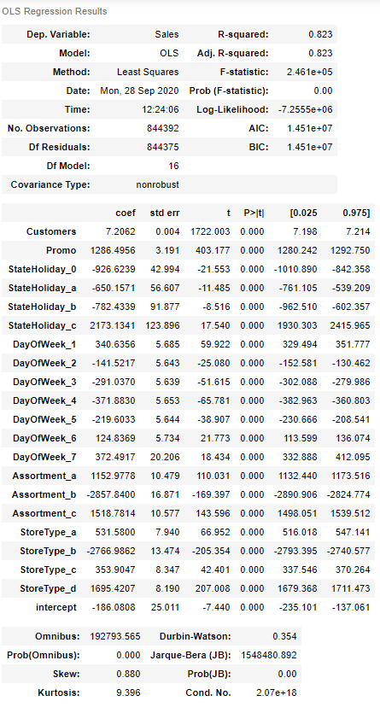
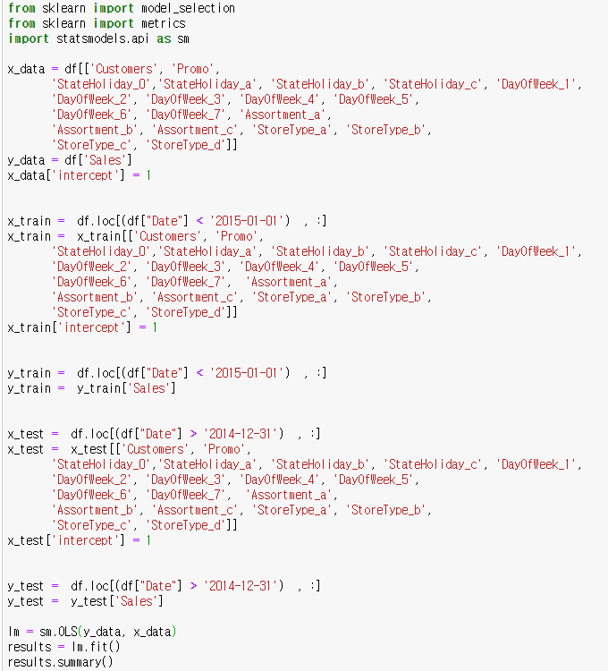

Modeling-OLS linear
I make OLS Model using these variables. And score is nice(0.823), t-test is okay but it might be have multicollinearity problem

Slide 28
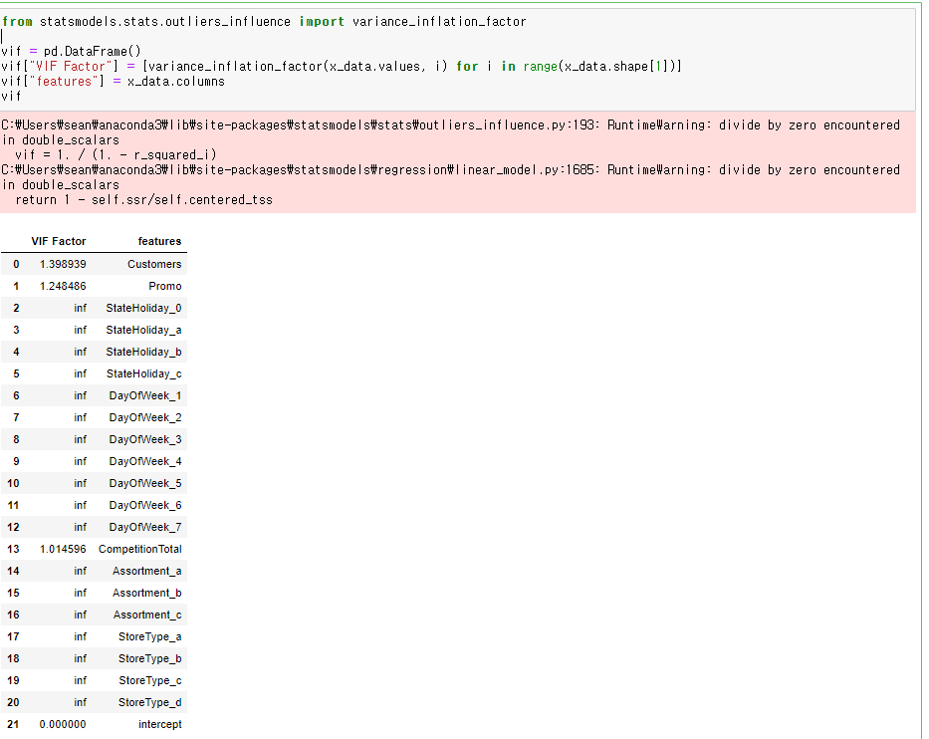
Modeling-OLS linear
Dummy variables have problem I think, but we can’t remove all of variables.

Slide 29
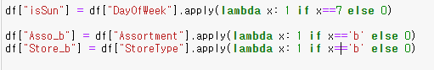
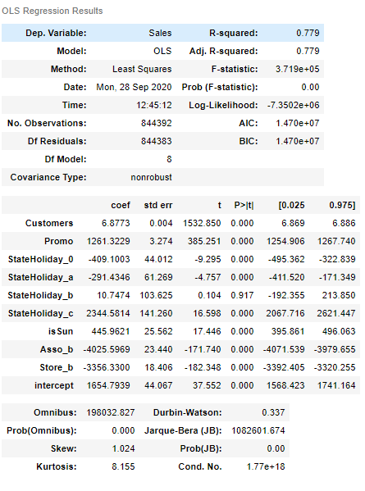
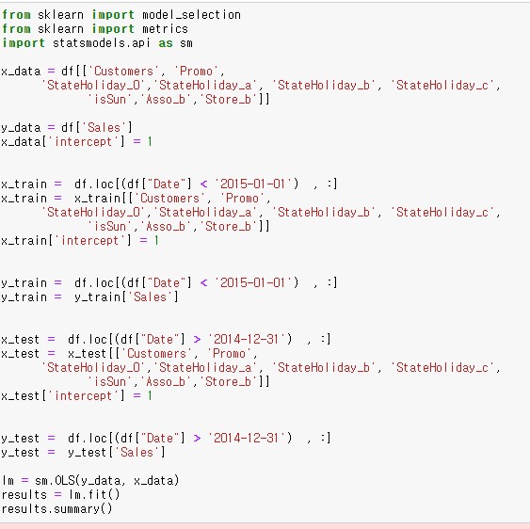
Modeling-OLS linear
And I make a new columns to reduce multicollinearity. And this is a new model’s result. But it still has multicollinearity.

Slide 30
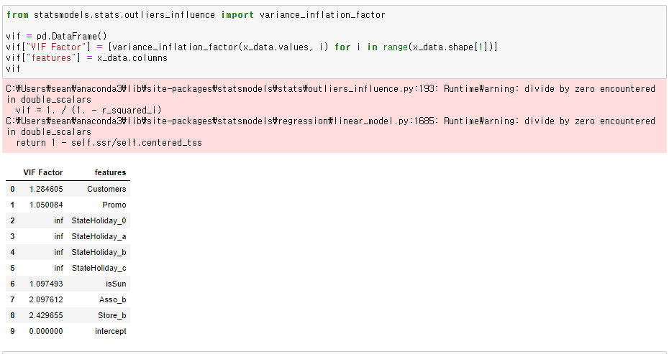
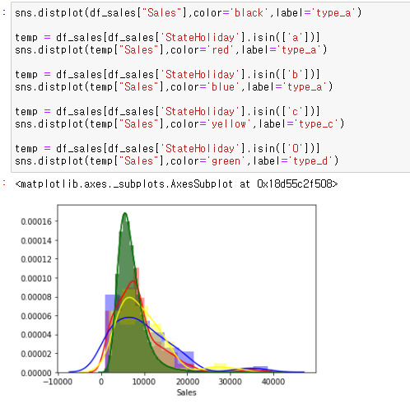
Modeling-OLS linear
And this is result of vif, and still have multicollinearity problem. But I think holiday a,b,c,0 have relation to sales. So I choose before data because after score is low and still have multicollinearity.

Slide 31
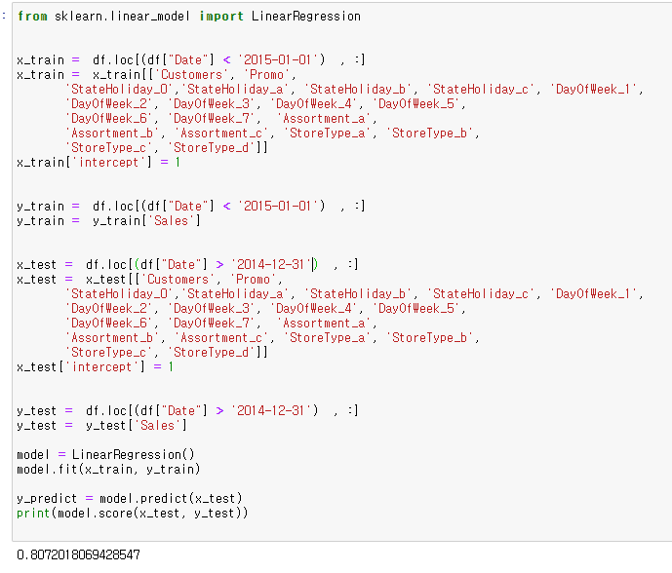
Modeling- linear
And for our purpose to predict 15 years sales, I separate 13,14 years data to train and 15 years data to test, and making linear model using sklearn. And result to separate data at will, score is 0.807. I think it is quite high. And a reason why I don’t use cross validation, the length of data is big to make a linear model, So I don’t use cross validation.

Slide 32
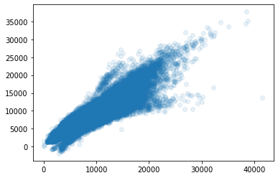
Modeling- linear
And for our purpose to predict 15 years sales, I separate 13,14 years data to train and 15 years data to test, and making linear model using sklearn. And result to separate data at will, score is 0.807. I think it is quite high. And a reason why I don’t use cross validation, the length of data is big to make a linear model, So I don’t use cross validation.

Slide 33
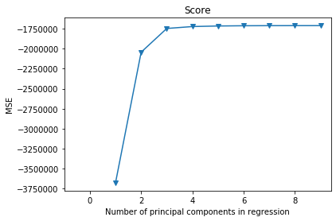
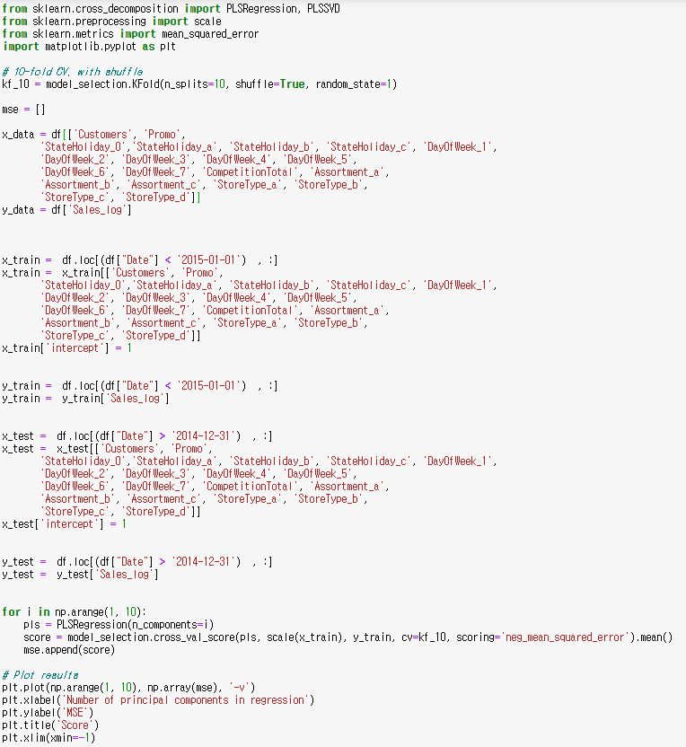
Modeling- PLS
And I make PLS model, and make a graph. So this is a result, and hyper parameter to choose variable z is 3.

Slide 34
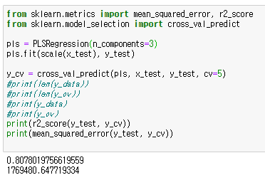



Modeling- PLS
And this is a result. I use 5, 10, 20 folds validation or separating data. And I think length is quite big, so I don’t have some reason why I use validation technique. So I think last one is best because of avoiding overfitting problem,

Slide 35


Modeling- Final
And this is final predict result

Slide 36
BA Assignment5
16102284 Lee SungHo

Slide 37


EDA
Before data preprocessing, I check null point. I collect ‘CompetitonDistance’ column’s null points and ‘CompetitonOpenSinceYear’ null points. As result, CompetitonOpenSinceYear is also null point when competitionDistance is null.
However competitionDistance isn’t null when CompetitonOpenSinceYear is null. However when CompetitonOpenSinceYear is null, CompetitonOpenSinceMonth always is null.

Slide 38



EDA – Sales.csv
And I check ‘sale.csv’ columns drawing histogram, boxplot, and Tukey test graph

Slide 39



EDA – Sales.csv
And I change variable to dummy variable like these picture

Slide 40
EDA – StoreType
Next, I print descriptive statistics group by Store type. There will be differences on each store type. And this is a result. I think both mean and variable isn’t very similar except b.

Slide 41
EDA – StoreType
So I make a boxplot and histogram. And I think that the remaining variables are different except for c. So store type variable can represent target data.

Slide 42
EDA – Assortment
Next, I print descriptive statistics group by assortment. There will be differences on each store type. And this is a result. However b’s count is 9, it is quite small to represent statistical knowledge. This is a reason why I merge. Moreover, I think both mean and variable isn’t very similar except b.

Slide 43
EDA – Assortment
So I make a boxplot and histogram. And I think that the remaining variables are different except for b. So assortment variable can represent target data.

Slide 44
EDA – CompetitionDistance
And there are nulls value at competition distance. So I fill 0 because there is no competition store. And a reason why use df_store column, I think there is no different between showing relation at store data or sales data.

Slide 45

EDA – CompetitionDistance
And I make a graph to show relation between competition distance and sales_mean. But there is no relation I think

Slide 46
EDA – CompetitionDistance
So I scale data multiply log. But there is no relation still. So I think competition distance can’t represent target data.

Slide 47




EDA – CompetitionDistance
So I make new variable ‘IsCompetition distance’. It mean store have or haven`t competition distance. And these is result.

Slide 48
EDA – CompetitionTotal
Then I make a new column ‘CompetitionTotal’ which represent ‘CompetitionOpenSinceYear’ and ‘CompetitionOpenMonth’. So I fill 0 which has no competitor data, and make a fomular. It is 12 * (2015- df_store['CompetitionOpenSinceYear'][i]) + (12 - df_store['CompetitionOpenSinceMonth'][i]). Because last year is 2015.

Slide 49

EDA – CompetitionTotal
For input this fomular, I merge sales dataframe and store dataframe. And I draw graph, competitionTotal and sales_mean, to show relation.
As a result, I think it can’t

Slide 50
EDA – CompetitionTotal
So I scale data to multiply log data. However there isn’t have relation too. So I thin it can’t represent target value.

Slide 51
EDA – CompetitionTotal
So I scale data to multiply log data. However there isn’t have relation too. So I thin it can’t represent target value.
But there are so many outlier, we can’t see relation because of that

Slide 52



EDA – CompetitionTotal
So I change and drop outliers and redraw graph. But it still doesn’t have relation with sales.

Slide 53

Create new variable
And I make year, month, day variable. Because I make some categorical variable that there is or isn’t competition store at day. So I merge competitionOpen data and I make day using random function. And I compare data’s date and competition’s open date. For these data, I create new variable ‘IsCompetitor’

Slide 54



Create new variable
And I make histogram, boxplot and ANOVA test group by Iscompetitor. As a result, there is quite different sales between Iscompetitor.

Slide 55


EDA – Date’s Year & Month
And I make boxplot and ANOVA test group by Date’s month. As a result, there is quite different sales between month.

Slide 56


EDA – Date’s Year & Month
Also there is difference too at Date’s Year.

Slide 57


EDA – Date’s Year & Month
And I change these to dummy variable

Slide 58
EDA – Date’s Year & Month
And I change these to dummy variable

Slide 59

EDA – Pro2
And I check Pro2 variable. First our train data’s year is 2013, 2014 and test data’s year is 2015. So I think there is no relation when promotion start not 2013 ~ 2015. So I change ‘Pro2’ data that only 1 when date’s year is 2013 ~ 2015. And I make boxplot and test ANOVA. As a result, there is different group by ‘IsPromo2’

Slide 60



EDA – Predict sales, Customers
And I make a new variables ‘Customers_predict’ and ‘Sales_predict’. Because store can’t know customers. So I input sales or customers mean of last week.

Slide 61




EDA – Predict sales, Customers
However, there are some null point. Because data starts 2013-01-01. So 2013-01-02 ~ 2013-01-08’ day’s Sales_predict and Customers_predict can’t exist. So I input sales and customers data because 2013 year data is training data not predict data, so I think it isn’t problem.

Slide 62


EDA – Final
And these are final dataframe’s columns which is made by me or original dataset.
For that I create train dataset and test dataset that separate by year.

Slide 63



Modeling - Linear
I create linear model, and check statistical value, score is high(0.5<0.736) and I think it isn’t overfitting. StateHoliday_c’s p value is quite high, but another dummy value is low, so I keep use this variable. Skew and kurtosis is quite high, I think sales_predict isn’t normal distribution. In conclusion, there are some problem, however I think it is quite nice, so I use these variable to make linear model under given conditions

Slide 64

Modeling - Linear
And this is a final result of multiple linear regression which score is 0.742

Slide 65

Modeling - Ridge
And I create ridge regression. For choosing hyper parameter, I make lots model using different alpha. And these are result.

Slide 66


Modeling - Ridge
For choosing hyperparameter, I create model using 5-fold cross validation. As a result, the best alpha value is 1000. So I create final ridge regression which hyperparameter is 1000 and score is 0.742

Slide 67

Modeling - Lasso
And I create lasso regression. For choosing hyper parameter, I make lots model using different alpha. And these are result.

Slide 68

Modeling - Lasso
For choosing hyperparameter, I create model using 5-fold cross validation. As a result, the best alpha value is 1. So I create final lasso regression which hyperparameter is 1. and score is 0.742

Slide 69

Modeling-Final
These are final results of using different models. Score is same by 0.742, however linear MSE is little bigger than ridge or lasso MSE. So I think these model is better model than linear. And L1 models are faster to learn or process than L2 models. If same result, I think faster model is better, so I think ridge model is best model.

Slide 70



Result
And these final result using ridge regression.

Slide 71


